Slide 1
Getting Started
With VB.NET

Slide 2
Slide Summary
Visual Basic.NET
The IDE Components of VB.NET
Visual Studio Project Types
The Members of a Control
A Few Common Properties
A Few Common Events
A Few Common Methods
Environment Options

Slide 3
Visual Basic.NET
Visual Basic.NET (VB.NET) is an object-oriented computer language that can be viewed as an evolution of Microsoft's Visual Basic (VB) implemented on the Microsoft .NET framework.
It can be used to develop console and graphical user interface applications along with Windows Forms applications, web sites, web applications, and web services
Visual Studio supports various languages by means of language services, which allow any programming language to be supported (to varying degrees) by the code editor and debugger.
Built-in languages include C/C++ (via Visual C++), VB.NET (via Visual Basic .NET), and C# (via Visual C#).
Support for other languages such as Chrome, F#, Python, and Ruby among others has been made available via language services which are to be installed separately. It also supports XML/XSLT, HTML/XHTML, JavaScript and CSS.

Slide 4
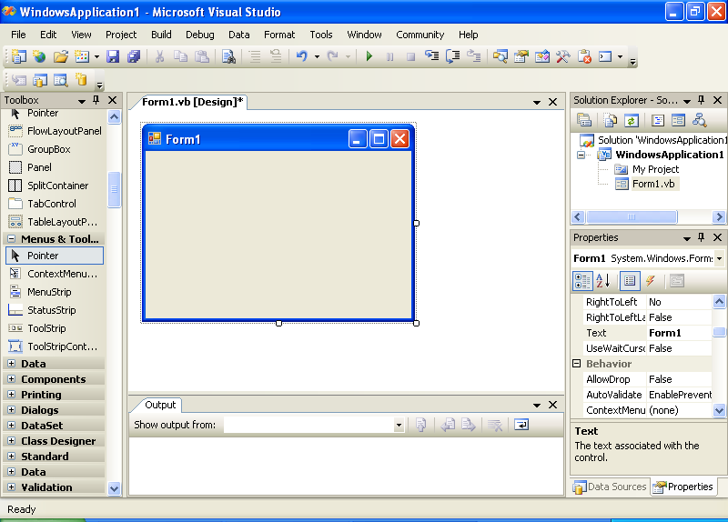
The IDE of VB.NET
Title Bar
Menu Bar
Solution
Explorer
Form
Toolbox Window
Output Window
Properties Window

Slide 5
The IDE Components of VB.NET
The IDE main menu provides the following commands, which lead to submenus. Most of the menus can also be displayed as toolbars.
File Menu Data Menu Edit Menu Format Menu View Menu Tools Menu
Project Menu Window Menu Build Menu Help Menu Debug Menu
The Toolbox Window
The Solution Explorer
The Properties Window
The Output Window
The Command Window
The Task List Window

Slide 6
The IDE Components
The Toolbox Window: It includes all the controls that we need to build our application’s interface.
The Solution Explorer: It contains a list of the items in the current solution. A solution may contain multiple projects and each project may contain multiple forms.
The Properties Window : (or, Property Bowser)
It displays all the properties of the selected component and their settings.
The Output Window: It is where many of the tools, including the compiler, send their output. We can send output to this widow from within our code with the Console.WriteLine method.
The Command Window: While testing a program, we can interrupt its execution by inserting a breakpoint. When the breakpoint is reached, the program’s execution is suspended and we can execute a statement in the Command window
The Task List Widow: It is usually populated by the compiler with error messages. We can double-click the error messages in this window, and the IDE will take us to the line with the statement in error - which we should fix.

Slide 7
Visual Studio Project Types
Windows Application
Console Application – very limited user interface. Output is displayed in a command prompt.
Windows Control Library – enables building our own custom controls to be used in a Windows application.
Class Library – has no visible interface; used to add specific functionality to the project.
Windows Service – long running applications; has no visible interface. These services can be started automatically when the computer is turned on, paused, and restarted.
ASP.NET Web Application – resides on a web server and services requests made through a browser.
ASP.NET Web Service - resides on a web server and services requests but does not return any HTML page..
Web Control Library – enables building our own custom controls to be used with web pages.

Slide 8
The Members of a Control
All objects in the Visual Basic language, including forms and controls, have their own properties, methods, and events.
Properties, methods and events constitute the programmatic interface of the control and are collectively known as the control’s members.
Properties can be thought of as an object's attributes, methods as its actions, and events as its responses.
For example:
A balloon's properties include attributes such as its height, diameter, and color.
A balloon also has known methods or actions that it can perform. It has an inflate method (filling it with helium), a deflate method (expelling its contents), and a rise method (letting go of it).
Balloons also have responses to certain external events. For example, a balloon responds to the event of being punctured by deflating, or to the event of being released by rising.

Slide 9
A Few Common Properties
Name – The control’s name.
Font – To determine the size, style etc.
Enabled – To determine whether we can interact with the control or not. (Value: True/False)
Size – Sets or returns the control’s size.
Tag - Holds some extra data we want to associate with a specific control.
Text – The text that appears on the control.
TabStop – Whether the control belongs to the tab order.
TabIndex – A numeric value that determines the position of the control in the Tab order.
Visible – Whether the control will be visible or not.

Slide 10
A Few Common Events
Click – Fired when a control is clicked.
Double-Click - Fired when a control is double-clicked.
Enter - Fired when a control receives the focus.
Leave - Fired when a control loses its focus.
MouseEnter - Fired when a mouse pointer enters the area of the control.
MouseLeave - Fired when a mouse pointer moves out of the area of the control.

Slide 11
A Few Common Methods
Focus - Moves the focus to the control.
Clear – To clear the contents of a control.
Hide / Show – To reveal or conceal the control.
Scale – Scales the control by a value specified as argument.
e.g. : txtName.Scale(0.75)
This will scale the textbox control down to 75% of its current size

Slide 12
IntelliSense
IntelliSense is a feature of the editor that displays as much information as possible, whenever possible. The IntelliSense option includes the following sub-options:
List Members: This option allows the editor to list all the members (properties, methods, events, ad argument list) in a drop-down list
Parameter Info: When the pointer is moved over a variable, method or property, we can see its declaration in a yellow tooltip
Quick Info: It displays information about commands abd functions. For example, when we type the opening parenthesis following the name of a function, its arguments will be displayed in a tooltip.
Complete Word: It enables one to complete the current word by pressing Ctrl + Spacebar. For example, if we type “txt” and press Ctrl + Spacebar, we will see a list of words that match.

Slide 13
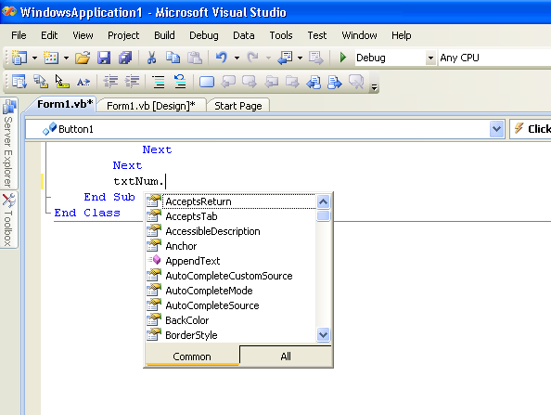

Slide 14
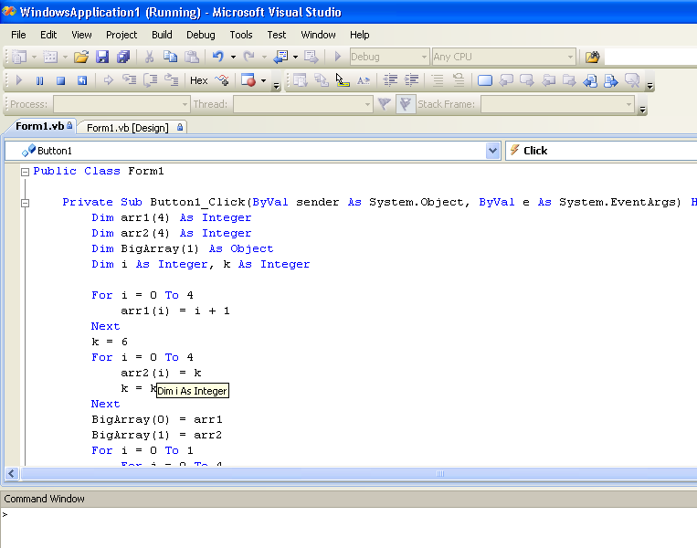

Slide 15
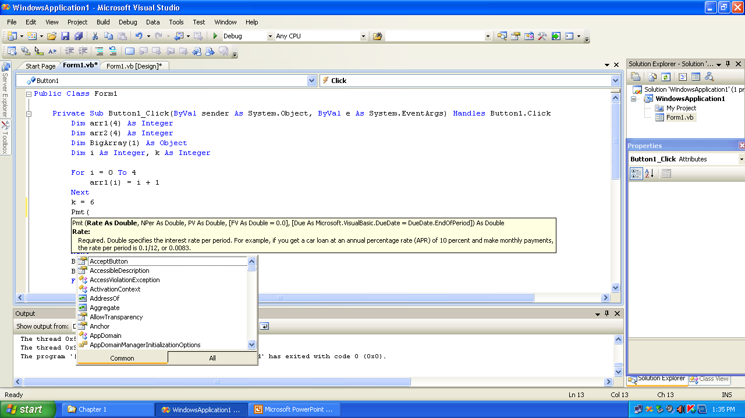

Slide 16
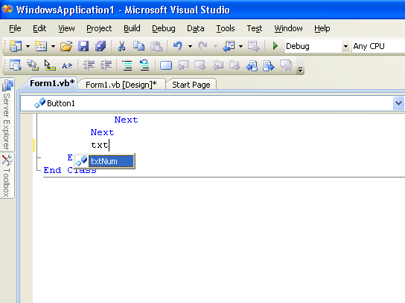

Slide 17
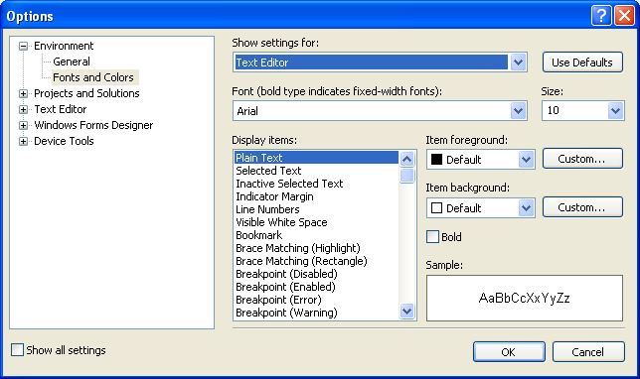
Environment Options
The Visual Studio IDE is highly customizable, i.e., we can change the default settings of the IDE.
To do so, we open the Tools menu and select Options (the last item in the menu).

